Slide 1
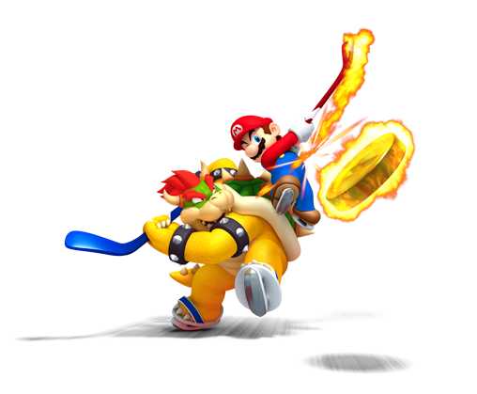
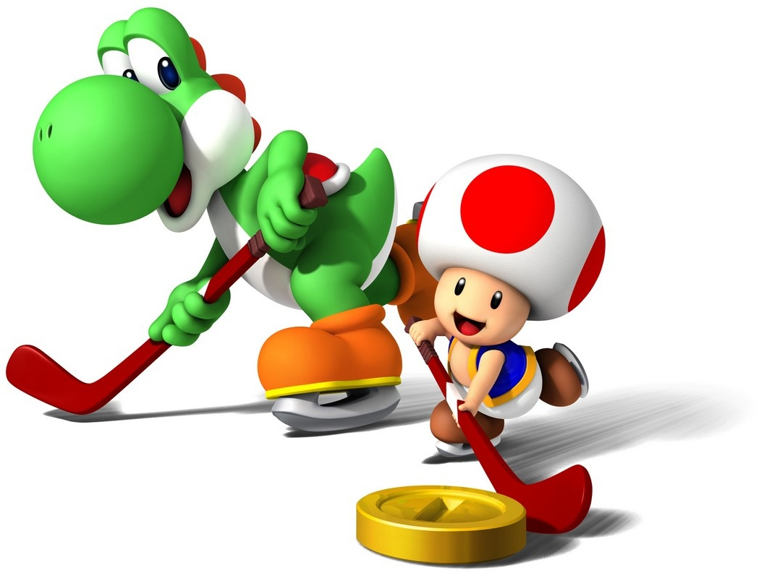
Hockey I
Produced by Dr. Mario | UNC STOR 390

Slide 2
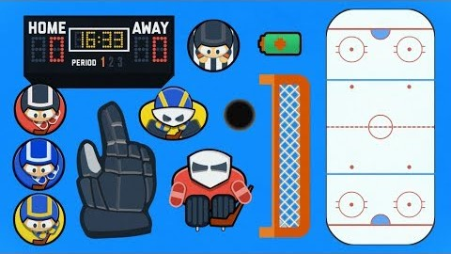
Hockey Explained

Slide 3
Player Performance
Unique to Hockey = Rapid Substitutions
Median Time for Unique Configuration is 8 Seconds
Most Shifts Are Between 30 and 50 Seconds
Constant Substitutions Make it Difficult to Value Players for Events Such as Goals
Plus-Minus (+/-)
Difference Between Goals Scored and Goals
Allowed Player is on Ice
Example of a Marginal Effect
Marginal Effect = Difference in Variable
Between 2 Groups

Slide 4
PLAYER PERFORMANCE
Player Performance
Problems With +/-
Variables Effecting +/- Other Than Player Skill
Ability of Player’s Teammates
Opponent Quality
Amount of Playing Time
Partial Effects = Difference in Variable
Between 2 Groups After Controlling
for Other Variables

Slide 5
PLAYER PERFORMANCE
Player Performance
Experiments = Optimal for Estimating Marginal Effects
Pick a Player
Randomly Sample from Pool of Other Players
Do This When Player is Playing and on Bench
Impractical and Need to Rely on Observational Data
Estimated Using Regression
Predict Number of Goals
Include All Covariates
Massive Set of Covariates
Requires a Ton of Data
Standard Linear Regression Fails
Over-Fit or Fail to Converge

Slide 6
PLAYER PERFORMANCE
Player Performance
Proportional Hazards Model
Studied by Thomas, Ventura, Jensen, Ma (2013)
Goals are Rare and Time is Almost Continuous
Introduction of Binary Goals
Purpose = Simplicity
+1 = Goal Scored by Home Team
-1 = Goal Scored by Away Team
$$q_{i}=P\left(Y_{i}=1\right)=P(Home Team Scored Goal i)$$

Slide 7

PLAYER PERFORMANCE
Player Performance
Logistic Regression Model
Team/Season
Player-Presence
Indicator Variables
Post-Season
Indicator
Special Teams:
Penalty Scenarios
Pulled Goalies
Player/Season

Slide 8



PLAYER PERFORMANCE
Player Performance
Partial Effect of Specific Player
Player-Only Version of Model
Regular Season Effect of Player j
Post-Season Effect of Player j
Home Players
Away Players

Slide 9
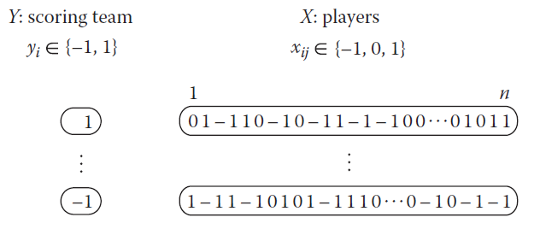
PLAYER PERFORMANCE
Player Performance
Player-Only Version of Model
Massive Model Matrix (All Hockey Players)

Slide 10



PLAYER PERFORMANCE
Player Performance
Regularized Approach
Representation of Log Odds
Negative Log Likelihood Objective Function
Penalization of Generalized Linear Model
Bernouilli Distribution in Exponential Family
Cost Function of Coefficients

Slide 11
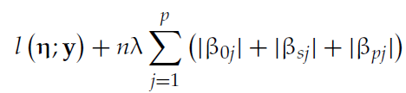

PLAYER PERFORMANCE
Player Performance
Lasso Penalization
Regularization Path
Each Lambda Leads to Different Estimates
Larger Lambda = Effects Pushed Towards 0
Cross-Validation Used to Choose Lambda
Alternative: Corrected Akaike Information Criterion
Penalizing Only Player Effects

Slide 12

PLAYER PERFORMANCE
Player Performance
Goal-based Effects
Utilized Play-by-Play Data from 2002-2014
Based on 2,439 Unique Players
Involved 69,449 Goals
Link Function Makes Coefficients Difficult to Interpret
Partial Probabilities for Individual Players
Given Goal Scored by Team,
What is the Probability Player j Scored?

Slide 13
PLAYER PERFORMANCE
Player Performance
Goal-based Effects
Translate Player Effects Into Scale of Goals
Partial Plus-Minus
Number of Goals Player j Was on the Ice For

Slide 14
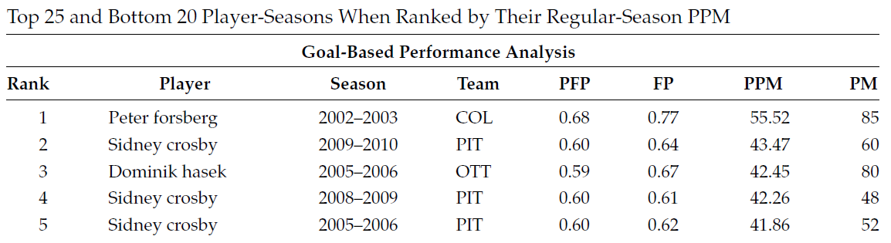
PLAYER PERFORMANCE
Player Performance
Goal-based Effects
Results
Completely Different Ranking

Slide 15
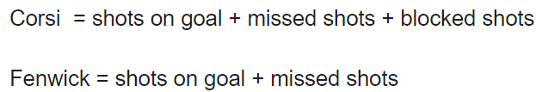
PLAYER PERFORMANCE
Player Performance
Problem With Previous Analysis
Focused on Goals
Other Important Events
Shots on Goals
Missed Shots
Blocked Shots
Corsi and Fenwick Statistics

Slide 16
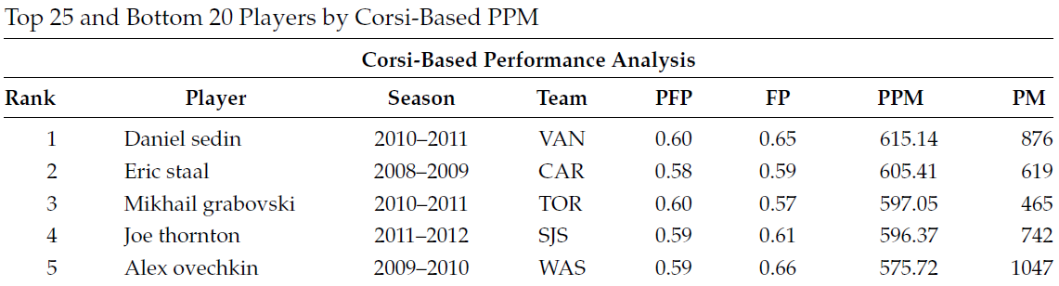
PLAYER PERFORMANCE
Player Performance
Results for Corsi-Based Partial +/-

Slide 17
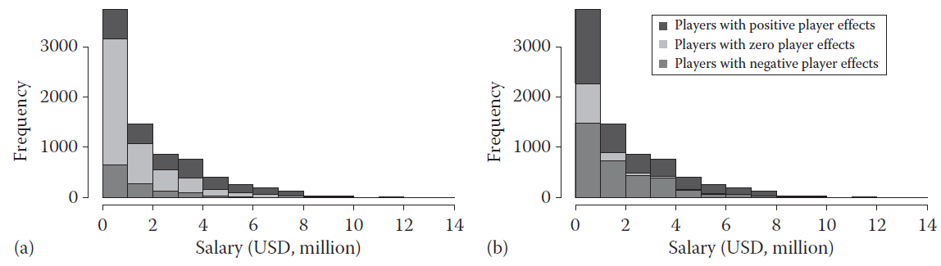
PLAYER PERFORMANCE
Player Performance
Salary and Performance
Goals-Based
Corsi-Based

Slide 18
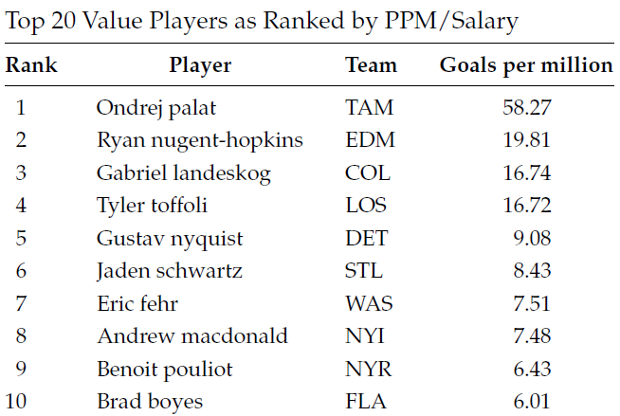
PLAYER PERFORMANCE
Player Performance
Salary and Performance
2013-2014 Season

Slide 19
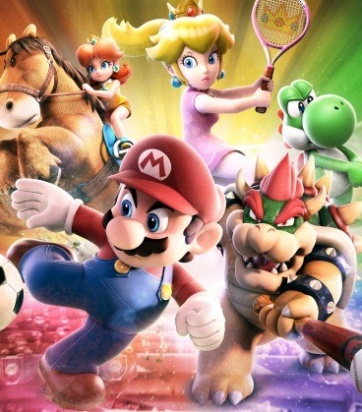
Final Inspiration
I will personally challenge anyone who wants to get rid of fighting to a fight.
-Brian Burke

